Slide 1

Cyber law presentation
Computer crime

Slide 2
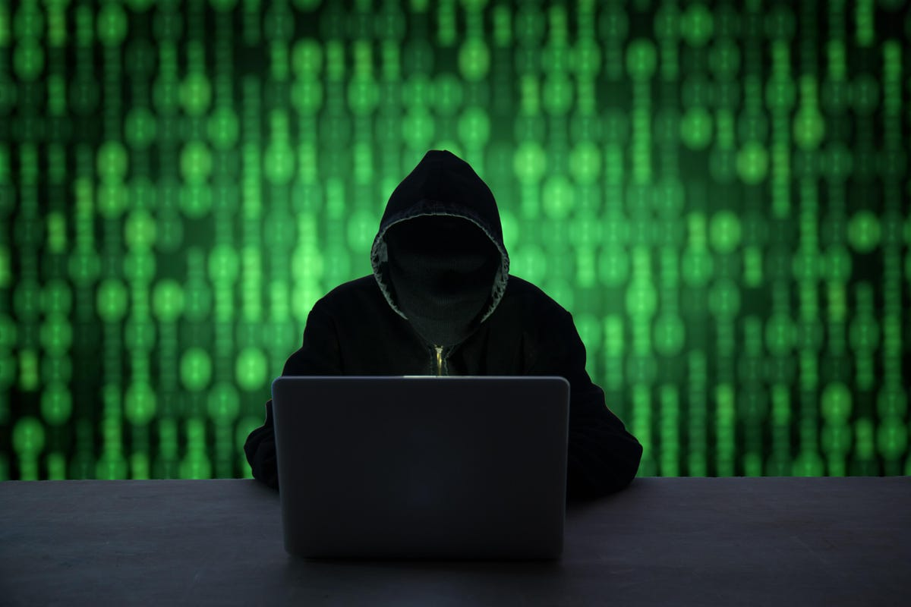

Computer Crime
Computer crime, also known as Cybercrime, is "criminal activity (such as fraud, theft, or distribution of child pornography) committed using a computer especially to illegally access, transmit, or manipulate data."
(Definition from Merriam-Webster, accessed: 03/02/22, https://www.merriam-webster.com/dictionary/cybercrime)
The most common types of computer crime are hacking, phishing, ransomware, denial of service attacks(DOS), identity theft, and fraud.

Slide 3

British Laws/Acts
Below are a list of British laws that are currently being used to prosecute people for committing computer crime.
Computer Misuse Act (1990)
Data Protection Act (2018)
The Communications Act (2003)
The IPA (2016)
The Malicious Communications Act (1988)
The Network and Information Systems Regulations (2018)

Slide 4
American Laws
As well as the UK the USA also had to address the legal aspect of the rise of computers and so in 1986 the US Congress Passed the Computer Fraud and Misuse act or CFAA for short, to strengthen the law in this new industry and help protect the American public and businesses.
Over the Years this act has been amended in order to help cope with advancements in computing as well as criminals and state actors trying to target different parts of US society.
However this is not the only law that covers cyber security as many US national security laws apply to data accessed that might be sensitive to the American government these indictments have been seen in high profile cases such as Edward Snowden and Chelsea Manning and the ongoing extradition case of Julian Assange.
Myles Daniels 2104397

Slide 5
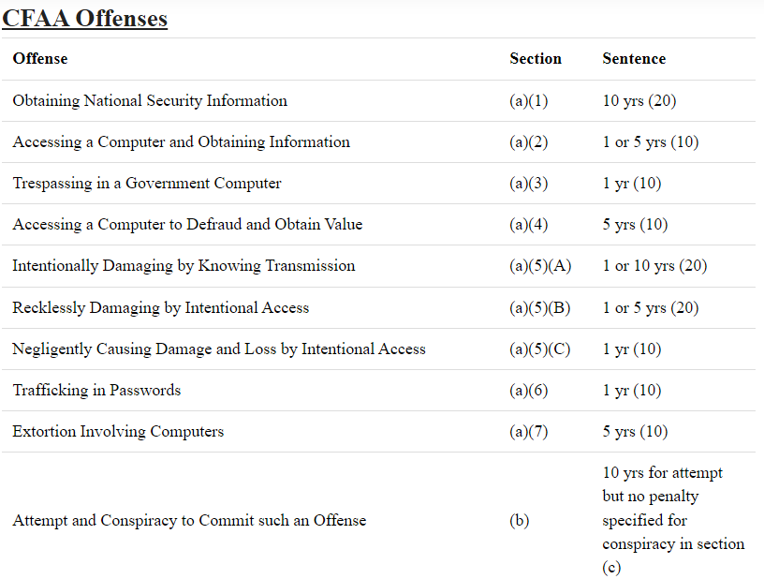
American Laws Continued
The computer laws in the USA are mainly Federal in nature owing to the complex cross state lines even international nature of computer crime and covers most of the traditional types of computer related offences and sets out lengthy prison sentences for such crimes as shown below.
However stricter penalties may apply for computer crimes if they are committed for the purpose of accessing sensitive government information in particularly on behalf of a foreign government such offences can be indicted as unauthorized disclosure or possession of sensitive information or even Treason.
Myles Daniels 2104397

Slide 6
British vs American law
We can also compare the penalties for offences under the main computer misuse acts in both the UK and USA.
To start off with the offence of unauthorised access of computer material under the CMA (1990) can be punished by up to 2 years in prison a similar offence under the CFAA can land up to 5 years imprisonment. The US has generally more harsher Punishments in related to prison sentences with both countries issuing unlimited fines in the worst cases however both countries have a harsh view on computer misuse that impact governmental or national security interests can result in life imprisonment
Due to the different governmental, Legal and Societal differences that exist between the us and the UK so does those differences exits in the laws overseeing computer related offences as well A Key example of this is that the UK has expanded its laws to cover other types of computer related offences such as online harassment and abuse whereas the US has minimal legislation in that regard owing to the first amendment of the US constitution
Another major difference is that the UK has legislation that covers the use, storage and handling of personal data namely the Data Protection Act whereas the USA has no such code or law for the handling of such data
Myles Daniels 2104397

Slide 7
Working within the law (what's illegal)
What is legal can also become a grey area when dealing with the government given that they often make use of secretive hacking divisions to gather information from around the world. The American NSA for example has a division known as Tailored Access Operations (TAO) which is funded on a secretive budget. This group of hackers gather information from around the world and answer to very few laws in relation to what they can't do when dealing with other countries operating under a 'don’t get caught' policy.
The American anti hacking law is controversially very vague in some areas and as such gives a lot of leeway towards ethical hackers. The term "exceeding authorized access" is the clause that causes the courts so many issues given how easily misinterpreted it could be from a legal standpoint.
Notes:
Laws you need to know as an Ethical Hacker - Lawordo.com accessed – 10/02/2022
Tailored Access Operations (TAO) revealed under the “Black Budget” | The Pentagon Papers 1971-2021 (tarheels.live) accessed – 10/02/2022
https://www.theverge.com/2021/6/5/22491859/supreme-court-van-buren-cfaa-hacking-law-scope-narrowed accessed – 10/02/2022

Slide 8
Continued
Other laws not directly linked to cybercrime can come into play as well such as identity theft laws which can be often breached by accident by hackers engaging in social engineering tactics to gain access to a system.
In the year 2021 cybercrime is at an all-time high with "Four in ten businesses (39%) and a quarter of charities (26%) report having cyber security breaches or attacks in the last 12 months." This figure alone should be evidence that despite laws being in place to prosecute hackers should they be caught the attacks themselves must first be either stopped or the hacker to be arrested before they even become relevant.
The simplest way of describing the laws restricting security specialists is that if they have been given permission to access a system then as long as that system is not damaged and no unauthorized information was accessed the hacker cannot be prosecuted under the current laws of either British or American legal systems.
Notes:
https://www.investopedia.com/terms/s/social-engineering.asp accessed 10/02/2022
https://www.gov.uk/government/statistics/cyber-security-breaches-survey-2021/cyber-security-breaches-survey-2021 accessed 10/02/2022

Slide 9
Are the laws effective?
Laws such as the General data protection act(GDPR) have been effective at ensuring that businesses and other online entities put forward a minimum level of security and protection for the data of its users which in turn has limited to number of small-time hackers gaining easy access to this data.
There are several cases of prosecution under the relevant cyber security laws that my teammates will cover in the coming slides including some high-profile recent attacks such as the WannaCry virus.
In summary the current laws are effective for what they are and filled the base requirement for some form of legal action to exist to prosecute cyber criminals under however in the current age do these laws go far enough? And are they too restrictive for security professionals? The answer to this is rather clear in that some parts of the law is accurate and acceptable to the modern age while others are still trying to live in the past and need to be updated rapidly.
This has been realized by the British government who are currently implementing new cyber laws in response to increased cybercrime during the coronavirus pandemic. Their statistics show nearly half (49%) of Brits purchased a smart device during this pandemic and as such have felt the need to up its cyber laws to protect them from harm.
Matthew Penman 2100908 (references in slide notes)
Notes:
https://ico.org.uk/for-organisations/guide-to-data-protection/guide-to-the-general-data-protection-regulation-gdpr/ accessed 10/02/2022
https://www.gov.uk/government/news/new-cyber-security-laws-to-protect-smart-devices-amid-pandemic-sales-surge accessed 15/02/2022

Slide 10
Computer Misuse Act (1990)
The 'Computer Misuse Act' was first introduced into British law in 1990.
This law sets out various computer crime offences
The offences include:
'Unauthorised access to computer material'
'Unauthorised access with intent to comit or facilitate commission of further offences'
'Unauthorised Acts with intent to impair, or with recklessness as to impairing the operation of a computer'
'Unauthorised acts causing, or creating risk of, serious damage'
'Making, supplying or obtaining articles for use in offence under Section 1, 3 or 3ZA'
(Information accessed on https://www.cps.gov.uk/legal-guidance/computer-misuse-act 07/02/2022)

Slide 11
Computer Misuse Act Implications
The penalties and consequences vary depending on which section the person has committed offence.
Section 1 – The maximum penalty is 2 years imprisonment.
Section 2 – The maximum penalty is 5 years imprisonment.
Section 3 – The maximum penalty is 10 years imprisonment.
Section 3ZA – The maximum penalty is 14 years imprisonment.
Section 3A – The maximum penalty is 2 years imprisonment.
(https://www.cps.gov.uk/legal-guidance/computer-misuse-act, 07/02/2022)

Slide 12
The Communications Act (2003)
As technology has advanced so too have the threats to it including existing technology’s a more recent issue with the online world of social media is the rise of online abuse people receive particularly through social media which has risen in the last 20 years.
As a result the UK government passed the communications act in order to address this and other advancements in communication technology.
A notable example of someone being prosecuted for this was a man named Paul chambers in 2010 who wrote on twitter in response to cancelled flights at Sheffield airport he would ‘blow it sky high’ he was found guilty for sending a malicious commutation and ordered to pay a £385 fine and £600 in costs though it was later overturned.
The key part of this legislation that we are focusing on is that it makes it an offence to send a malicious communication over social media was now a criminal offence and a punishment for this includes a unlimited fine or/and maximum of 2 years imprisonment.
Myles Daniels 2104397

Slide 13

Investigatory Powers Act (2016)
The investigatory powers act of 2016 brought together a number of different investigatory powers that where already available to law enforcement and other government agencies (MI5, GCHQ, etc.) into one new bill. This made these powers easier to understand and therefore less difficult to apply properly.
On top of this it changed how interception warrants (warrants that are given to allow communications like phone calls, emails and letters to be observed) are authorized. After authorization by a secretary of state, it must also be given approval by a judge before it could be used.
It also created an Investigatory Powers Commission in order to make sure that investigatory powers are being used properly in accordance with the law

Slide 14
Investigatory Powers Act (2016) (Continued)
However arguably the most impactful part of the act in relation to computer crime is the inclusion of a legal obligation for csp’s (communication service providers, in this instance referring to any company that provides an internet service) to retain its “internet connection records” for one year. This does not mean that they had to keep a record of what subpages a user visited, only the actual webpage.
This specific part of the act made it very controversial, due to claims that it may negatively affect people's privacy, therefore earning it the nickname "the Snooper's Charter". Article 19, a human rights organization focused on promoting freedom of expression and information, called it one of the most draconian pieces of surveillance legislation, and stated that it "offered a template for authoritarian regimes".

Slide 15
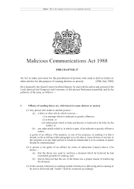
The Malicious Communications Act (1988)
This act prosecutes people for sending messages online that are indecent or grossly offensive, a threat, or sending false information that is known by the sender
Important legislation even when it first came out as the number of people using online messaging was starting to increase around this time
Similar to the communications act of 2003
If a person has been found to guilty of committing one of these offences, they could be sentenced to prison for 6-12 months

Slide 16
The Network and Information Sytems Regulations (2018)
The Network and Information Systems Regulations are intended to establish a common higher base level of security (both physical and digital) for essential network and information systems that could cause a large level of disruption if they were to fail
The bill introduced a series of regulations related to security which any major operators of essential services or relevant digital service providers (companies that provide a search engine, online marketplace or cloud computing service).
The regulations requires organizations to ‘identify and take appropriate and proportionate measures to manage the risks posed to the security of network and information systems’, essentially legally mandating the organizations to have an acceptable level of physical and cyber security.

Slide 17
Data Protection Act (2018)
Finally we come to the data protection act of 2018 which solidified the rules around how data is stored, handled and shared. This act is mainly aims at organisations and businesses in order to assure that data is controlled in a way that protects the general public from identity theft and financial crimes in the form of financial data being leaked or being accessed by those not authorised with large fines being issues to those found in breach of the data protection law. The information commissioners office handles enforcement of the act.
The Fines for offences under this act can range up to £17.5 million or 4% of the companies global turnover whichever one is greater this massive financial penalties are an incentive for companies to secure customers or users data I the next paragraph will list some examples of companies (some well known) being fined under this act
Notable companies fined
British Airways was fined £20 million in 2020 for a data breech affecting 40,000 customers. Though they had originally planned to fine them £183 million
Also in 2020 Marriott International Hotels was fined relating to a breech in 2014 that was not discovered until 4 years later
Myles Daniels 2104397

Slide 18
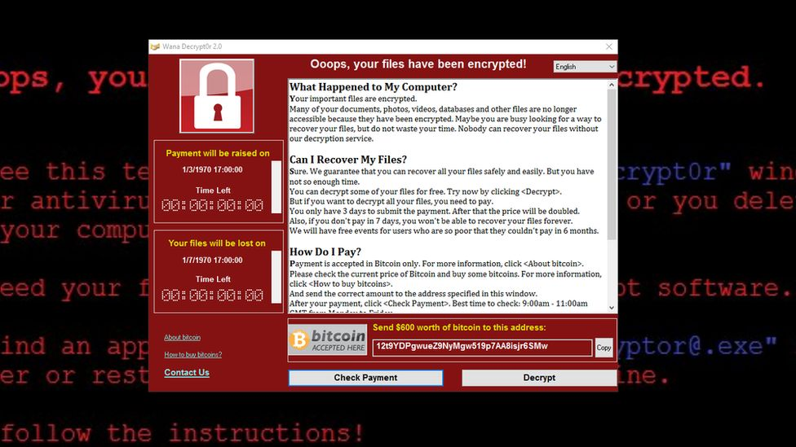
WannaCry Ransomware Attack
This was a global attack that occurred in May 2017
The ransomware attack affected over 150 countries and more than 200,000 machines/computers
Targeted computers that were using the windows OS
This was the largest ransomware attack ever to happen as it affected many large companies and services including the NHS
The reason this cyberattack was successful was because of the outdated computer systems some of these services were still using. If they had been updated, then this could have been avoided.
To this date, no group or individual has been convicted for committing this crime, however if there was then there would be serious consequences.
(Information from https://www.acronis.com/en-gb/articles/nhs-cyber-attack/ & https://www.kaspersky.co.uk/resource-center/threats/ransomware-wannacry - image from www.bbc.co.uk, 08/02/2022)

Slide 19
Alex Bessell Case
Alex Bessell was convicted of committing cybercrime offences and was sentenced to 2 years in jail.
The police found several programs on his computer which aimed at infecting computers and retrieving personal data such as email and banking login details.
He launched over 100 cyberattacks on companies Skype and Google with the use of thousands of bots.
Alex also made thousands of pounds in a business he created on the deep web which sold products that let people conduct their own cyberattacks.
(Information accessed from https://www.bbc.co.uk/news/uk-england-42733638, on 08/02/2022)

Slide 20
Reference List
https://serocu.police.uk/computer-misuse-act/#:~:text=Section%203ZA%20of%20the%20Computer,is%2014%20years%20in%20prison
https://www.merriam-webster.com/dictionary/cybercrime
https://www.cps.gov.uk/legal-guidance/computer-misuse-act
https://www.acronis.com/en-gb/articles/nhs-cyber-attack/
https://www.kaspersky.co.uk/resource-center/threats/ransomware-wannacry
https://www.bbc.co.uk/news/uk-england-42733638
https://freemanlaw.com/computer-fraud-abuse-act-cfaa/
https://www.gov.uk/data-protection
https://www.itgovernance.co.uk/dpa-and-gdpr-penalties
https://iclg.com/practice-areas/cybersecurity-laws-and-regulations/england-and-wales
https://www.nationalcrimeagency.gov.uk/what-we-do/crime-threats/cyber-crime

Slide 21
Reference List Continued
https://lawtimesjournal.com/cyber-laws-in-united-kingdom/
https://www.cityam.com/uk-loses-2-5bn-in-fraud-and-cyber-crime-cases-during-2021/
https://www.ramsac.com/blog/cybercrime-legislation-uk/
https://cms.law/en/int/expert-guides/cms-expert-guide-to-data-protection-and-cyber-security-laws/united-kingdom
https://www.bbc.co.uk/news/technology-57011639
https://www.theguardian.com/media/2017/nov/30/press-freedom-at-all-time-low-journalist-safety-article-19-v-dem-study
https://assets.publishing.service.gov.uk/government/uploads/system/uploads/attachment_data/file/473745/Factsheet-Internet_Connection_Records.pdf
https://www.gchq.gov.uk/information/investigatory-powers-act
https://www.gov.uk/government/collections/investigatory-powers-bill
https://ico.org.uk/for-organisations/the-guide-to-nis/security-requirements/
https://www.legislation.gov.uk/uksi/2018/506/contents

